Slide 1
Usable Privacy for Biometric Data in XR
Institute of Computer Science & Campus-Institute Data Science
Usable Security And Privacy
Sonal Lakhotia

Slide 2
Contents
Institute of Computer Science & Campus-Institute Data Science
Introduction to XR
Biometric Data and Importance
Usability of Biometric Data in XR
Biometrically Inferred Data and User Privacy
Privacy Concerns in XR
Regulations for User Privacy in XR
Limitations and Future Scope
Conclusion
References

Slide 3
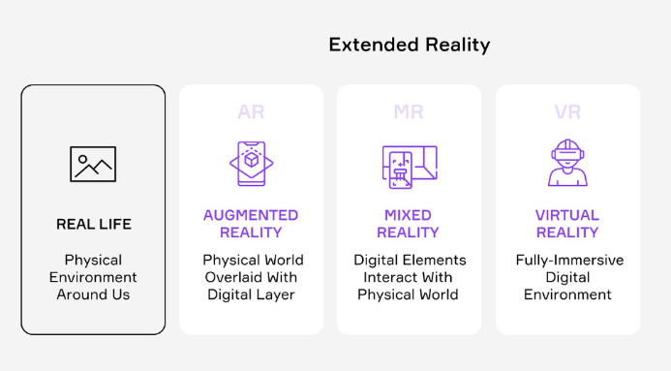
Introduction to XR
Institute of Computer Science & Campus-Institute Data Science
XR (Extended Reality) suite composes virtual, augmented, and mixed reality technologies.
Composition of XR [1]
XR technologies find usage in a plethora of domains like media, healthcare, education, gaming, entertainment, automotive, etc.
Application areas of these technologies include training, simulation, R&D, medical, and therapy. [2]
[1] https://sensoriumxr.com/articles/what-is-extended-reality
[2] N. Morris, “imperative developing standards for safety and security in XR environments”,xrsi.org,” 2021

Slide 4
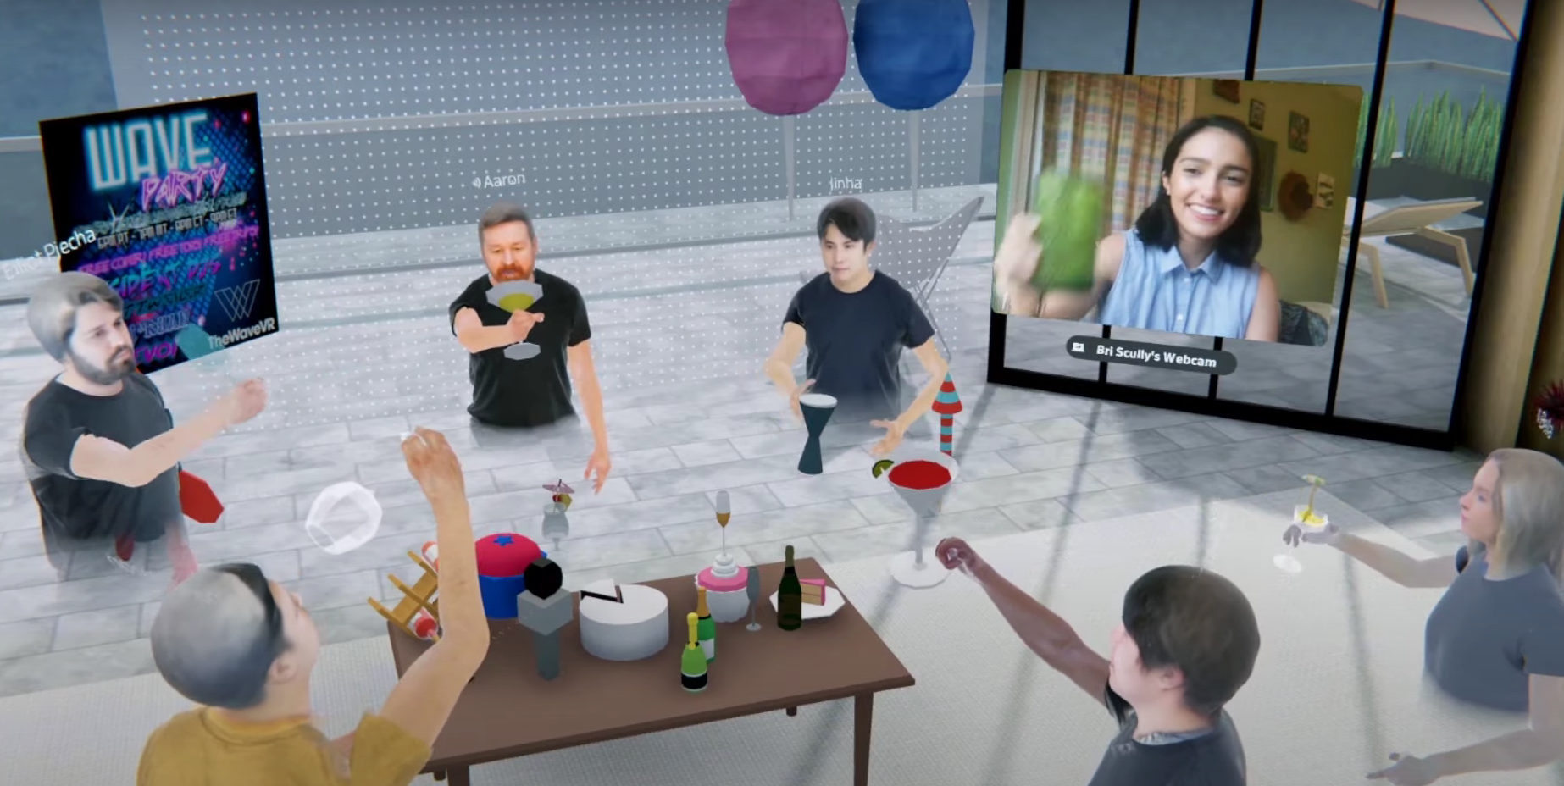
Introduction to XR
Institute of Computer Science & Campus-Institute Data Science
XR devices are empowered by user data. For example – demographic, location, movement, and biometrics.
Physical and Virtual worlds are becoming convergent with XR.
A VR social network - spectrum called Metaverse [2].
Users can represent themselves as avatars.
[2] N. Morris, “an imperative developing standards for safety and security in XR environments”,xrsi.org,” 2021.
Creating Avatars in Metaverse

Slide 5
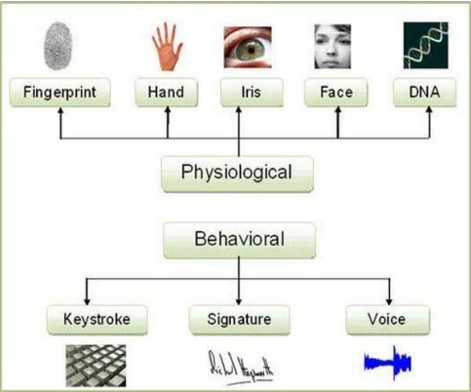
Biometric Data and Importance
Institute of Computer Science & Campus-Institute Data Science
Biometric data characterize users’ personal information, such as specific physical, behavioral or physiological attributes.
Biometric data accounts for unique information from a user’s face, fingerprint, voice, or DNA and is a widely used authentication mechanism.
Types of Biometrics [3]
[3] T. Sabhanayagam, V. P. Venkatesan, and K. Senthamaraikannan, “A comprehensive survey on various biometric systems,” International Journal of Applied Engineering Research, vol. 13, no. 5, pp. 2276–2297, 2018

Slide 6
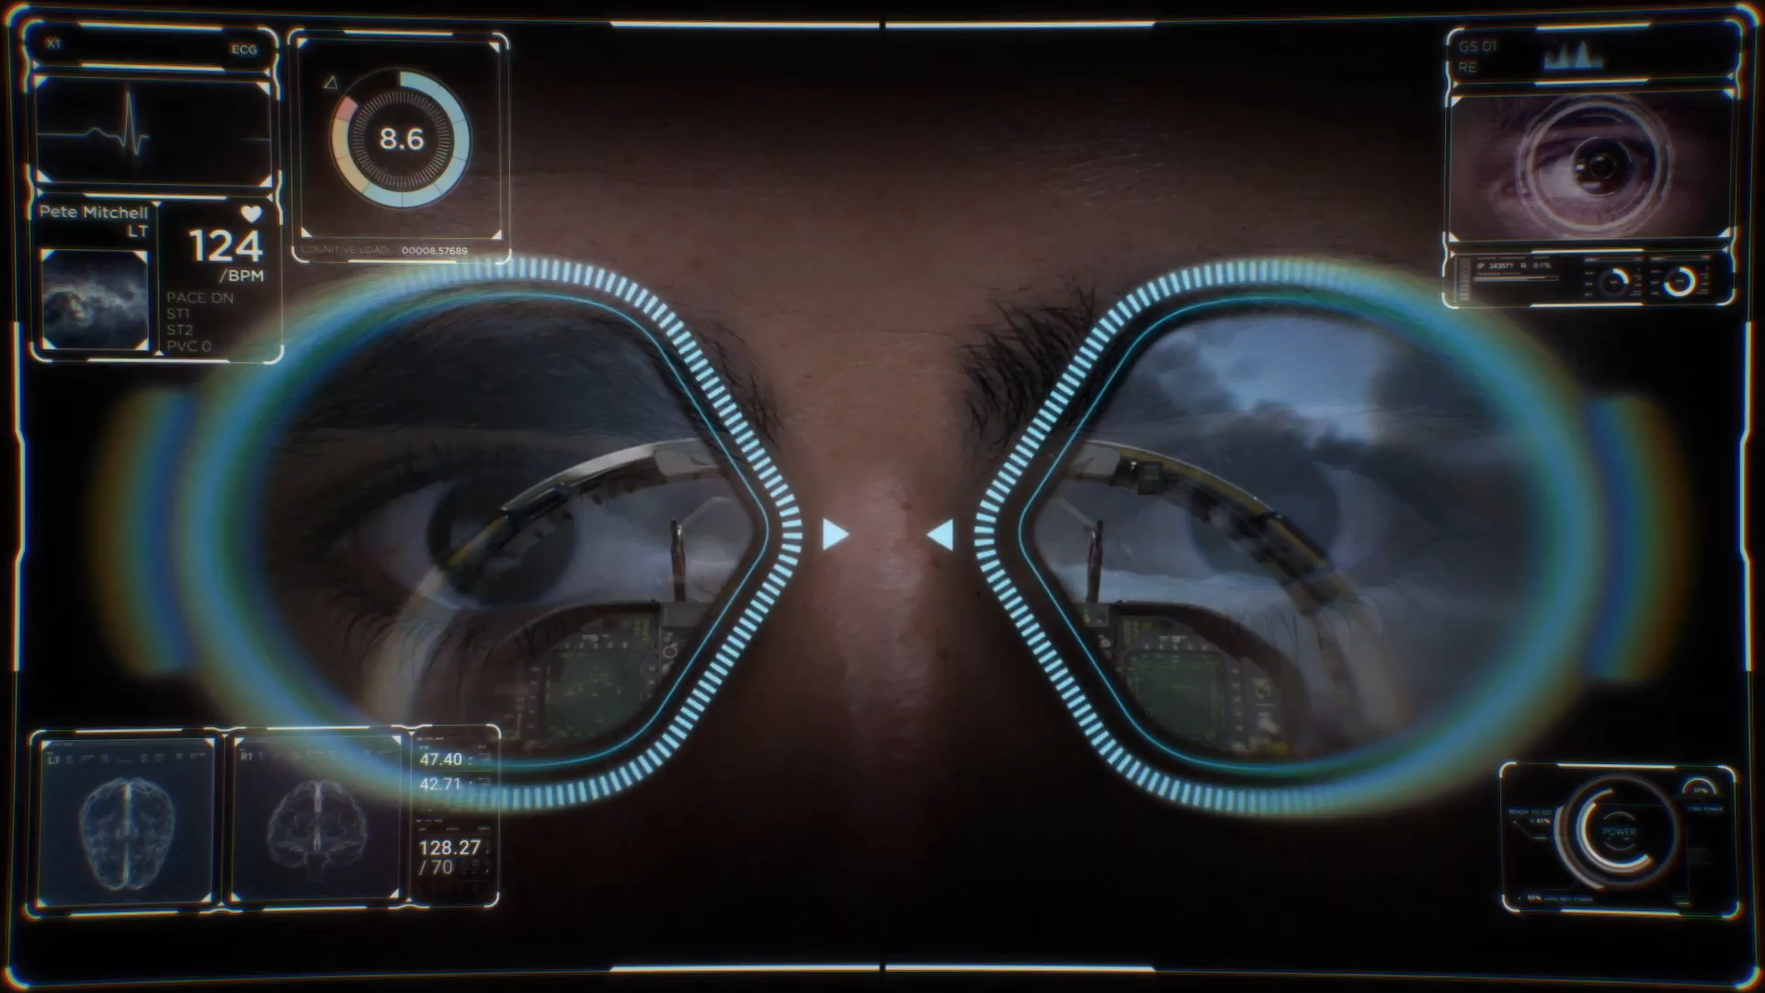
Usability of Biometric Data in XR
Institute of Computer Science & Campus-Institute Data Science
Biometric data complements XR technology by extensive monitoring and feedback of the user’s blood pressure, heart rate, respiration rate, and pulse oximetry.
The collection of sensitive data enables the creation of an even more immersive experience for the user.
HP Omnicept provides revolutionized VR using real-time insights from users [4]
[4] https://www.hp.com/us-en/vr/reverb-g2-vr-headset-omnicept-edition.html#tab=software

Slide 7
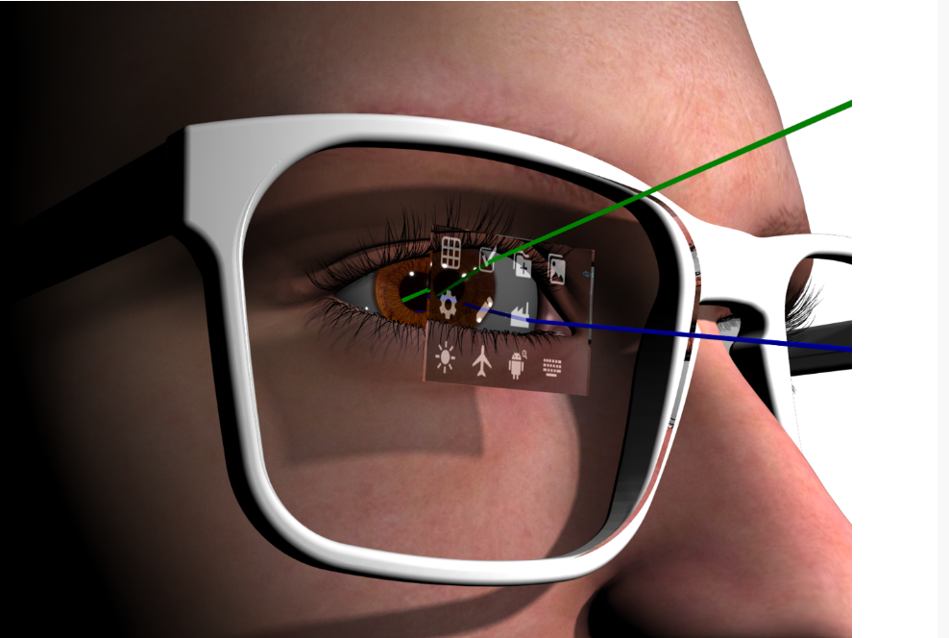
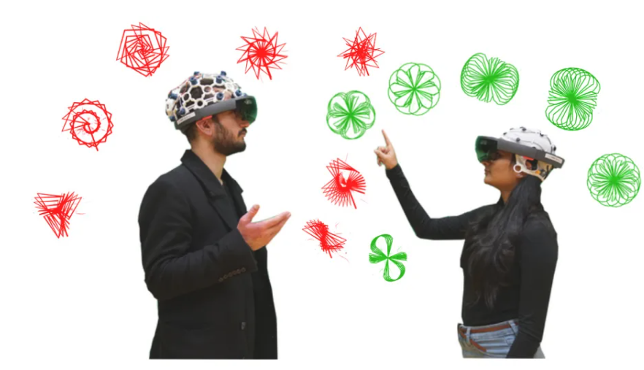
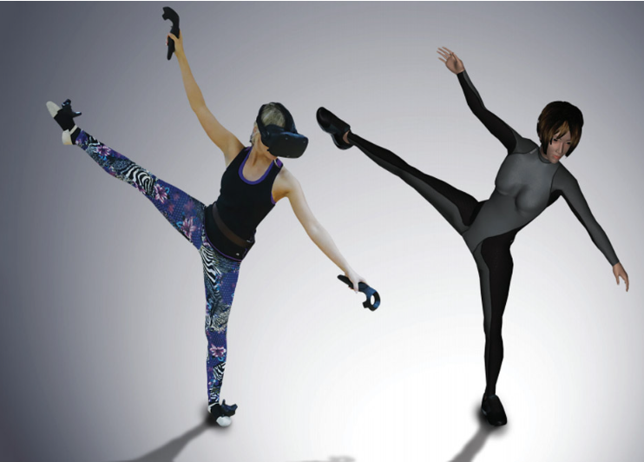
Usability of Biometric Data in XR
Institute of Computer Science & Campus-Institute Data Science
Eye tracking collects data concerning the user’s field of vision, changes in pupil size, and the object the user is looking at.
Brain-Computer Interface (BCI) technologies measure brain activity and adapt and respond to the user's neural signals.
Hand and Body tracking technology uses tracked images of a user’s hands for the development of secure and adaptive user interfaces for virtual reality.
Eye Tracking An experiment with OpenBCI Hand and Body tracking

Slide 8
Usability of Biometric Data in XR
Institute of Computer Science & Campus-Institute Data Science
XR technologies gauge user behaviors and emotional states through biometric tracking:
Analysis of difficulty while performing tasks.
User body authenticating a unique individual enables security.
Users’ interests can be determined in an immersive virtual experience.
Eye movement, body movements, blood pressure, etc. provide insights into the user’s mental and physical states.
Behavioral biometrics are used for user authentication in virtual interfaces

Slide 9
Biometrically Inferred Data and User Privacy
Institute of Computer Science & Campus-Institute Data Science
“True Character is revealed in the choices a human being
makes under pressure –
the greater the pressure, the deeper the revelation,
the truer the choice to the character’s essential nature”[5]
-Robert McKee
[5] McKee, R.(1997). Story: Substance, structure, style, and the principle of screenwriting

Slide 10
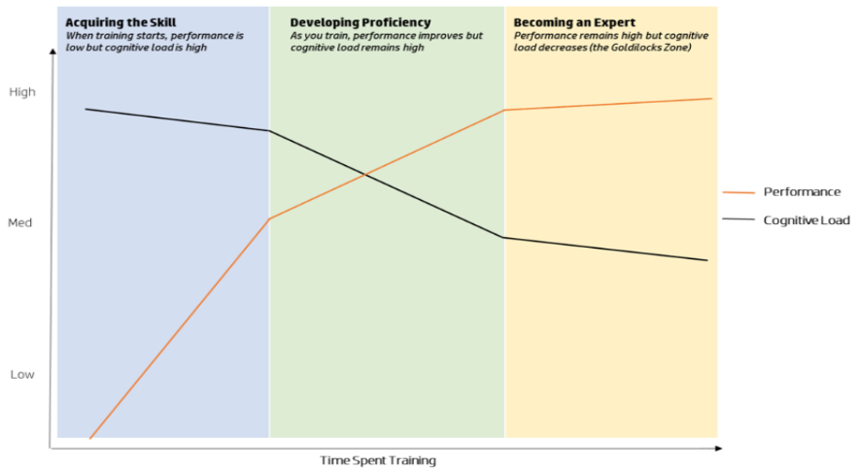
Usability of Biometric Data in XR
Institute of Computer Science & Campus-Institute Data Science
User performance is monitored and virtual experience can be tailored.
If the cognitive load is very high, it leads to weak performance as users are mentally overloaded. [6]
When the cognitive load is at optimal levels, users are energized, engaged, and able to complete the task comfortably[6].
Expertise in a skill is indicated by cognitive load [6]
[6] https://developers.hp.com/omnicept/blog/hp-labs-cognitive-load?language=it

Slide 11
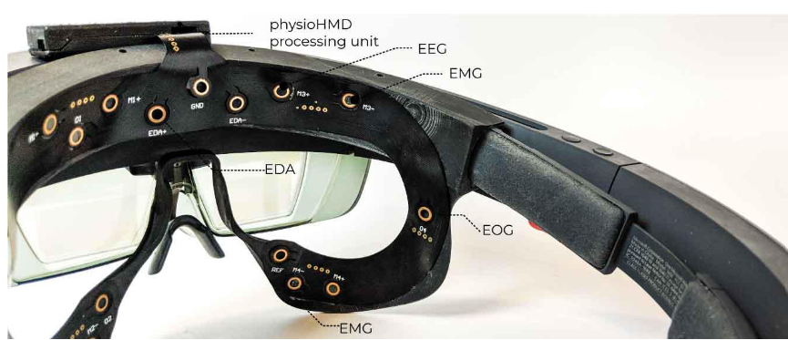
Usability of Biometric Data in XR
Institute of Computer Science & Campus-Institute Data Science
XR device, Galea, interprets Electromyogram (EMG), Electrooculogram (EOG), physiological signals (Electroencephalogram (EEG), Heart Rate (HR), Electrodermal Activity (EDA) in real-time and uses them to develop personalized, novel interactions, as well as evaluates virtual experiences. For example, bringing facial expressions to digital avatars.
Galea, a tool at the intersection of VR and neuroscience [7]
[7] Bernal, G.(2021, April 15). Developing Galea: An open-source tool at the intersection of VR and neuroscience https://www.media.mit.edu/posts/galea/

Slide 12
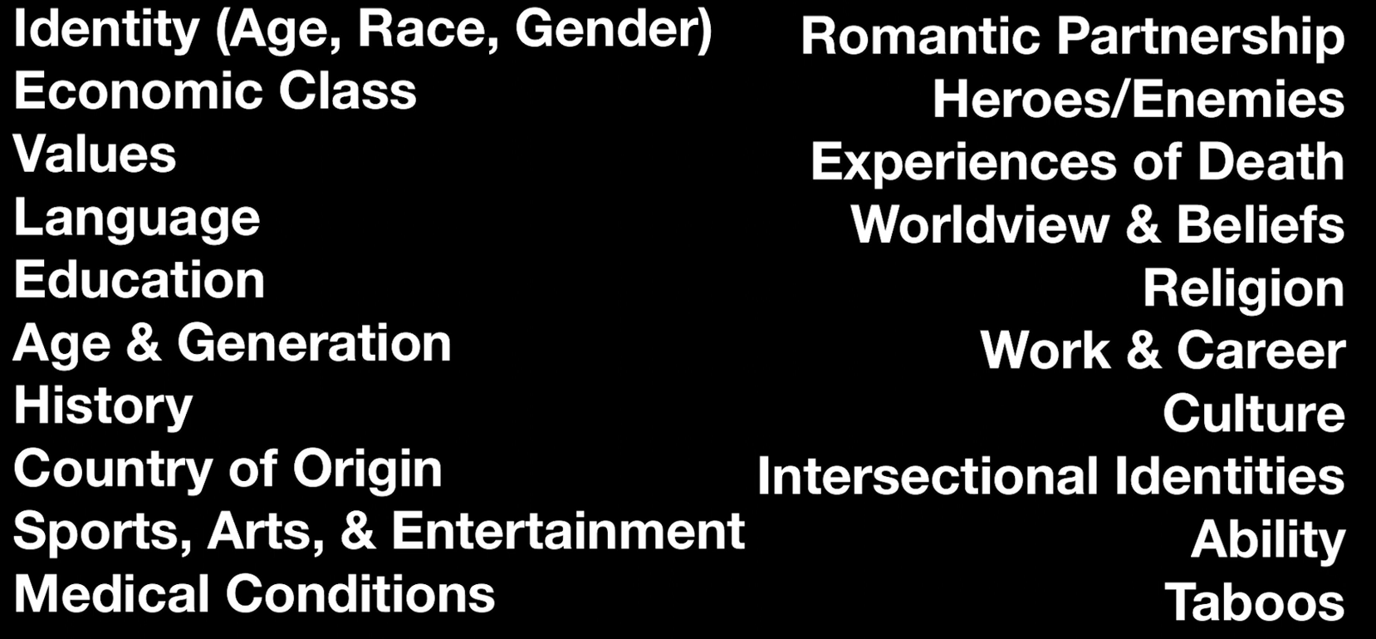
Biometrically Inferred Data and User Privacy
Institute of Computer Science & Campus-Institute Data Science
BID is a collection of data generated from behavioral, physical, and psychological biometrics.
User location, behavioral characteristics, and psychographics can be determined.
User Contexts that can be determined using biometric data
XR developers and businesses might use user-specific data to improve their products.
User privacy may be jeopardized if data is stored in XR devices.

Slide 13
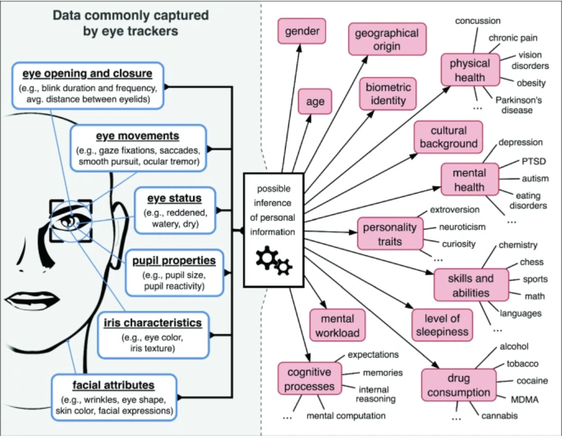
Privacy Concerns in XR
Institute of Computer Science & Campus-Institute Data Science
Biometrically inferred data through eye tracking can reveal a lot of personal information [8]
[8] J. L. Kroger, O. H.-M. Lutz, and F. Muller, “What does your gaze ¨reveal about you? on the privacy implications of eye tracking,” in IFIP International Summer School on Privacy and Identity Management. Springer, 2019, pp. 226–241

Slide 14
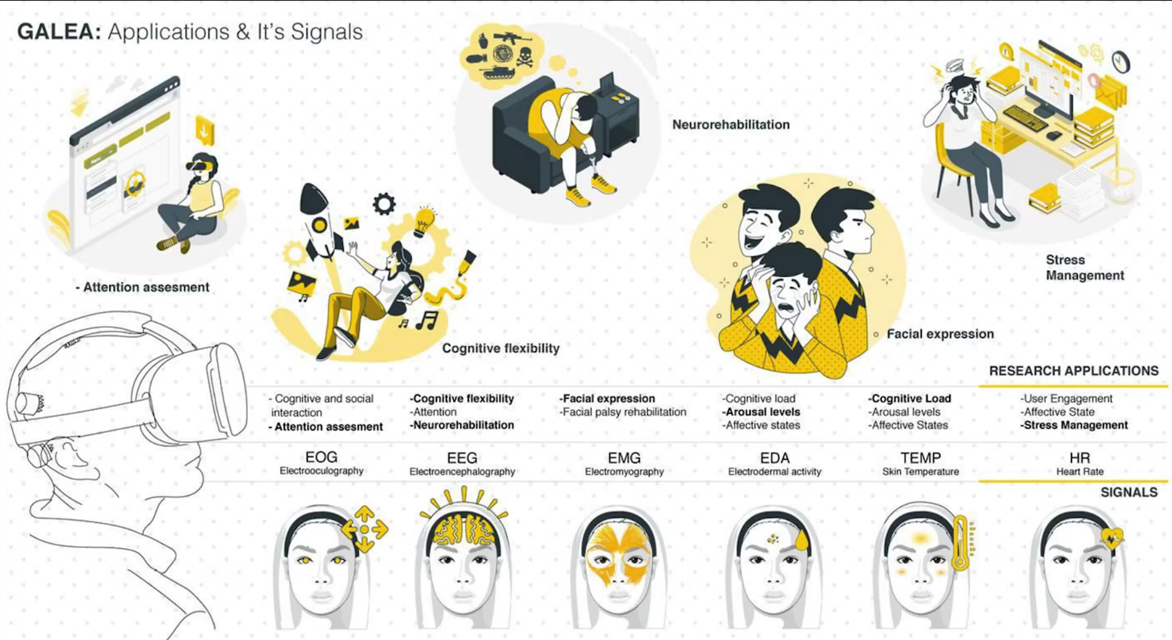
Privacy Concerns in XR
Institute of Computer Science & Campus-Institute Data Science
Galea provides insight into the user’s various behavioral and psychological aspects.[7]
[7] Bernal, G.(2021, April 15). Developing Galea: An open-source tool at the intersection of VR and neuroscience

Slide 15
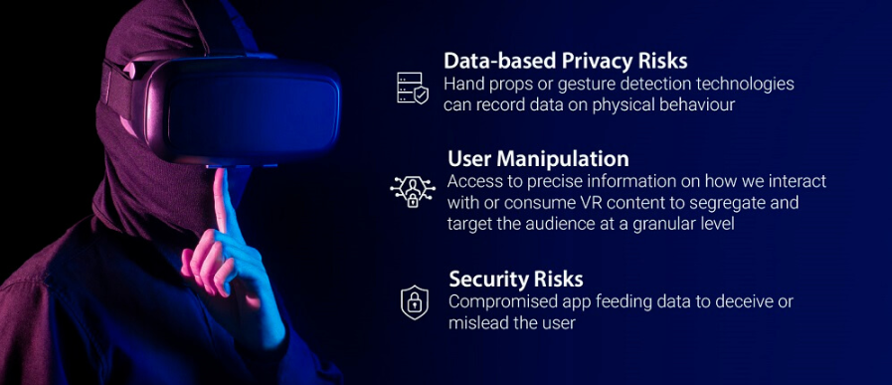
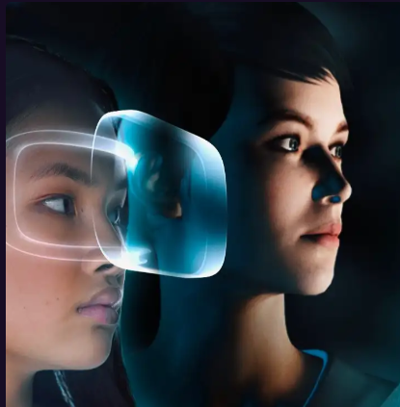
Privacy Concerns in XR
Institute of Computer Science & Campus-Institute Data Science
Privacy Risks Eye Tracking for Virtual Avatar
In an immersive XR experience, sensitive personal information is unconsciously collected.
Third parties can model a digital twin in the virtual environment.
If someone gets access to a digital twin, they might access the physical asset too, causing damage.
It restricts navigating virtual environments in anonymity.

Slide 16
Regulations for User Privacy in XR
Institute of Computer Science & Campus-Institute Data Science
The General Data Protection Regulation (GDPR) aims to empower data privacy for all users in the EU [9]. Regulations for collecting biometric data as per the GDPR framework impose the following:
Data processing is only lawful if the interested party authorizes the personal data for one or more declared purposes [9].
If the user consents to use personal details in the contract and if it is not necessary for the performance of the contract, the consent is not considered freely given [9].
The scope of data processing should be specified exclusively, even if it is by an authority, public body, or the manager [9].
All operators must notify the supervisory authority within 72 hours of receiving notification of a personal data breach.
[9] E. K. . A. Bedat. (2018) Virtual reality, augmented reality & biometric data after 2017. [Online]. Available: https://blog.klarislaw.com/vr-ar-virtual-reality-augmented-realitybiometric-data-after-2017-ed-klaris-alexia-bedat-a15e9cb000a1

Slide 17
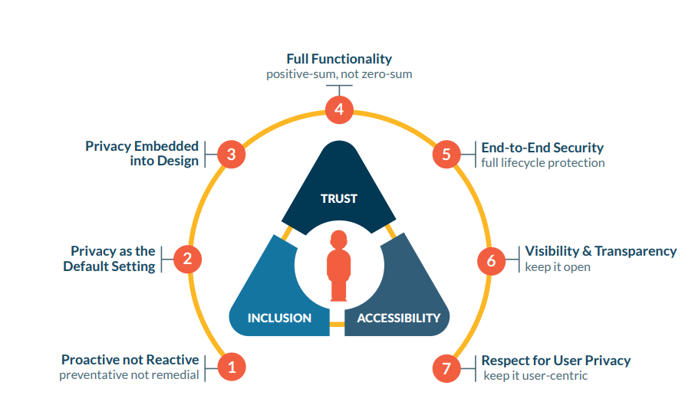
Regulations for User Privacy in XR
Institute of Computer Science & Campus-Institute Data Science
The XRSI Privacy Framework aims to deliver transparent, easy-to-understand solutions that are inclusive while protecting individual privacy by design and default.
It includes a modern understanding of identity and respect for the user’s characteristics and
preferences [10].
XRSI Privacy Framework helps achieve Human-Centric Privacy by design [10]
[10]The initiative, XR Safety. "The XRSI privacy framework." (2020).

Slide 18
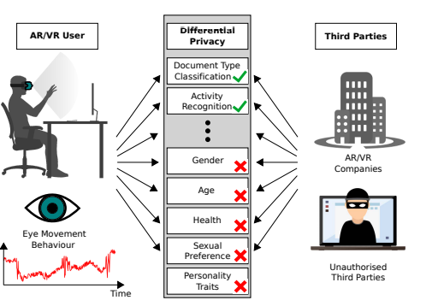
Regulations for User Privacy in XR
Institute of Computer Science & Campus-Institute Data Science
A method to safeguard user privacy by preventing the re-identification of users or revealing their gender information is differential privacy [11].
Differential privacy prevents third parties, such as companies or hackers, from extracting personal characteristics from eye movements while maintaining the usefulness of data for non-personal data.
Eye tracking using differential Privacy [11]
[11] J. Steil, I. Hagestedt, M. X. Huang, and A. Bulling, “Privacy-aware eye tracking using differential privacy,” in Proceedings of the 11th ACM Symposium on Eye Tracking Research & Applications, 2019, pp. 1–9.

Slide 19
Limitations and Future Scope
Institute of Computer Science & Campus-Institute Data Science
Even if the tracking data is anonymized by removing the name, raw biometric data can relatively re-identify a user based on their unique movements with ease [2].
Additional techniques including secure storage and clear access restrictions are required to anonymize sensitive and biometric-derived data.
XR platforms should try to adopt voluntary proposals such as ”Neuro Rights” to ensure that users’ intellectual privacy is not violated [12]. They include:
The right to identity
2. The right to the agency
3. The right to mental privacy
4. The right to fair access to mental augmentation
5. The right to protection from algorithmic bias
[12] Yuste, R., Genser, J. and Herrmann, S., 2021. It’s time for neuro-rights. Horizons, 18, pp.154-164.

Slide 20
Future Scope
Institute of Computer Science & Campus-Institute Data Science
As the XRSI Privacy Framework continues to evolve, the following topics remain on the future roadmap:
Geolocation and geo privacy.
Standardized semiotic labels for XR.
Adoption and enforcement of the framework
Data protection impact assessment for Spatial Computing and XR.
Analysis of dark patterns and their impact on trust in Spatial Computing and XR.
XR Data Classification Framework.
Technical standards for informed consent (human readable labeling schema for adoption).
[9]The initiative, XR Safety. "The XRSI privacy framework." (2020).

Slide 21
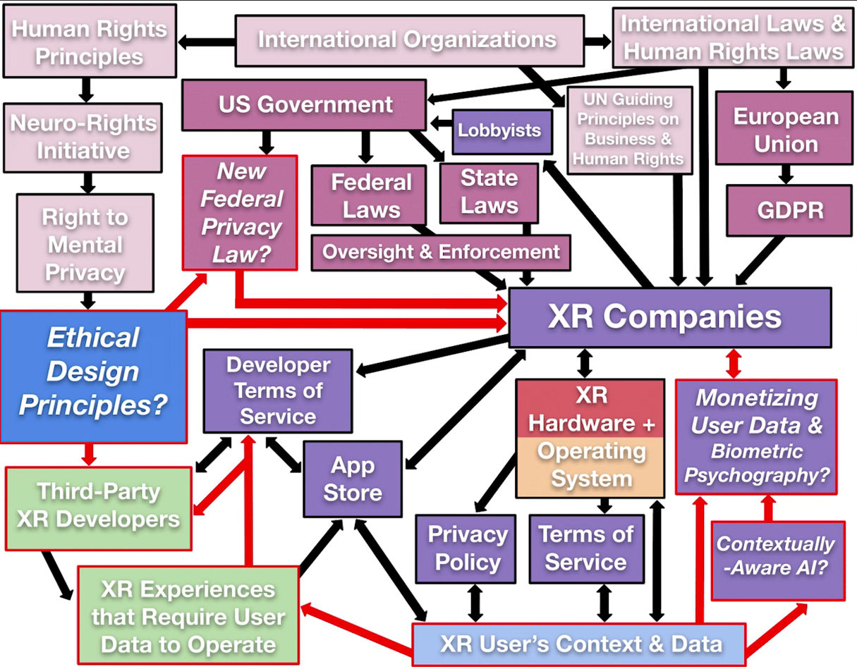
Future Scope
Institute of Computer Science & Campus-Institute Data Science
A mechanism to preserve biometric data and mental privacy in the US[14]
[14] https://voicesofvr.com/988-defining-biometric-psychography-to-fill-gaps-in-privacy-law-to-cover-xr-data-brittan-hellers-human-rights-perspectives/

Slide 22
Conclusions
Institute of Computer Science & Campus-Institute Data Science
AR and VR technologies are not transitory trends that fade.
Creating user-tailored experiences requires collecting attributes unique to the user to allow real-time customization.
User biometric data preservation is crucial for every company that creates or develops XR.
Individuals should have the right to choose how their identity (or its representations/modifications, such as digital twins or enhanced appearances) is viewed and appropriated by others in XR [13].
XR stakeholders and developers should adopt responsible and transparent measures to deliver a cutting-edge XR experience.
[13] McGill and Mark, “The IEEE global initiative on ethics of extended reality (XR) report–extended reality (XR) and the erosion of anonymity and privacy,” Extended Reality (XR) and the Erosion of Anonymity and Privacy - White Paper, pp. 1–24, 2021.

Slide 23
References
Institute of Computer Science & Campus-Institute Data Science
[1] https://sensoriumxr.com/articles/what-is-extended-reality
[2] N. Morris, “an imperative developing standards for safety and security in XR environments”,xrsi.org,” 2021
[3] T. Sabhanayagam, V. P. Venkatesan, and K. Senthamaraikannan, “A comprehensive survey on various biometric systems,” International Journal of Applied Engineering Research, vol. 13, no. 5, pp. 2276–2297, 2018
[4] https://www.hp.com/us-en/vr/reverb-g2-vr-headset-omnicept-edition.html#tab=software
[5] McKee, R.(1997). Story: Substance, structure, style, and the principle of screenwriting
[6] https://developers.hp.com/omnicept/blog/hp-labs-cognitive-load?language=it
[7] Bernal, G.(2021, April 15). Developing Galea: An open-source tool at the intersection of VR and neuroscience https://www.media.mit.edu/posts/galea/
[8] J. L. Kroger, O. H.-M. Lutz, and F. Muller, “What does your gaze ¨reveal about you? on the privacy implications of eye tracking,” in IFIP International Summer School on Privacy and Identity Management. Springer, 2019, pp. 226–241
[9] E. K. . A. Bedat. (2018) Virtual reality, augmented reality & biometric data after 2017. [Online]. Available: https://blog.klarislaw.com/vr-ar-virtual-reality-augmented-realitybiometric-data-after-2017-ed-klaris-alexia-bedat-a15e9cb000a1
[10] The initiative, XR Safety. "The XRSI privacy framework." (2020).
[11] J. Steil, I. Hagestedt, M. X. Huang, and A. Bulling, “Privacy-aware eye tracking using differential privacy,” in Proceedings of the 11th ACM Symposium on Eye Tracking Research & Applications, 2019, pp. 1–9.
[12] Yuste, R., Genser, J. and Herrmann, S., 2021. It’s time for neuro-rights. Horizons, 18, pp.154-164.
[13] McGill and Mark, “The IEEE global initiative on ethics of extended reality (XR) report–extended reality (XR) and the erosion of anonymity and privacy,” Extended Reality (XR) and the Erosion of Anonymity and Privacy - White Paper, pp. 1–24, 2021.
[14] https://voicesofvr.com/988-defining-biometric-psychography-to-fill-gaps-in-privacy-law-to-cover-xr-data-brittan-hellers-human-rights-perspectives/

Slide 24
Thank You.
Institute of Computer Science & Campus-Institute Data Science

